Slide 1

Autonomous Navigation for Mobile Robotics
Presented By:
Muhammad Ans Akhtar 16-MCT-08
Muhammad Shoaib 16-MCT-49
Muhammad Uzair Sajid 16-MCT-53
Mir Usama UL Haq 16-MCT-63
Supervised By:
Dr. Ahmed Nouman

Slide 2
Problem Statement
“To develop a fully automated mobile robot that utilizes state of the art technology for solving Autonomous Navigation Tasks”

Slide 3
Outline
Introduction
Problem Statement
Flowchart
Design
ROS Environment
Physical Implementation
Hardware
Modern Tool Usage
Implementation Areas

Slide 4
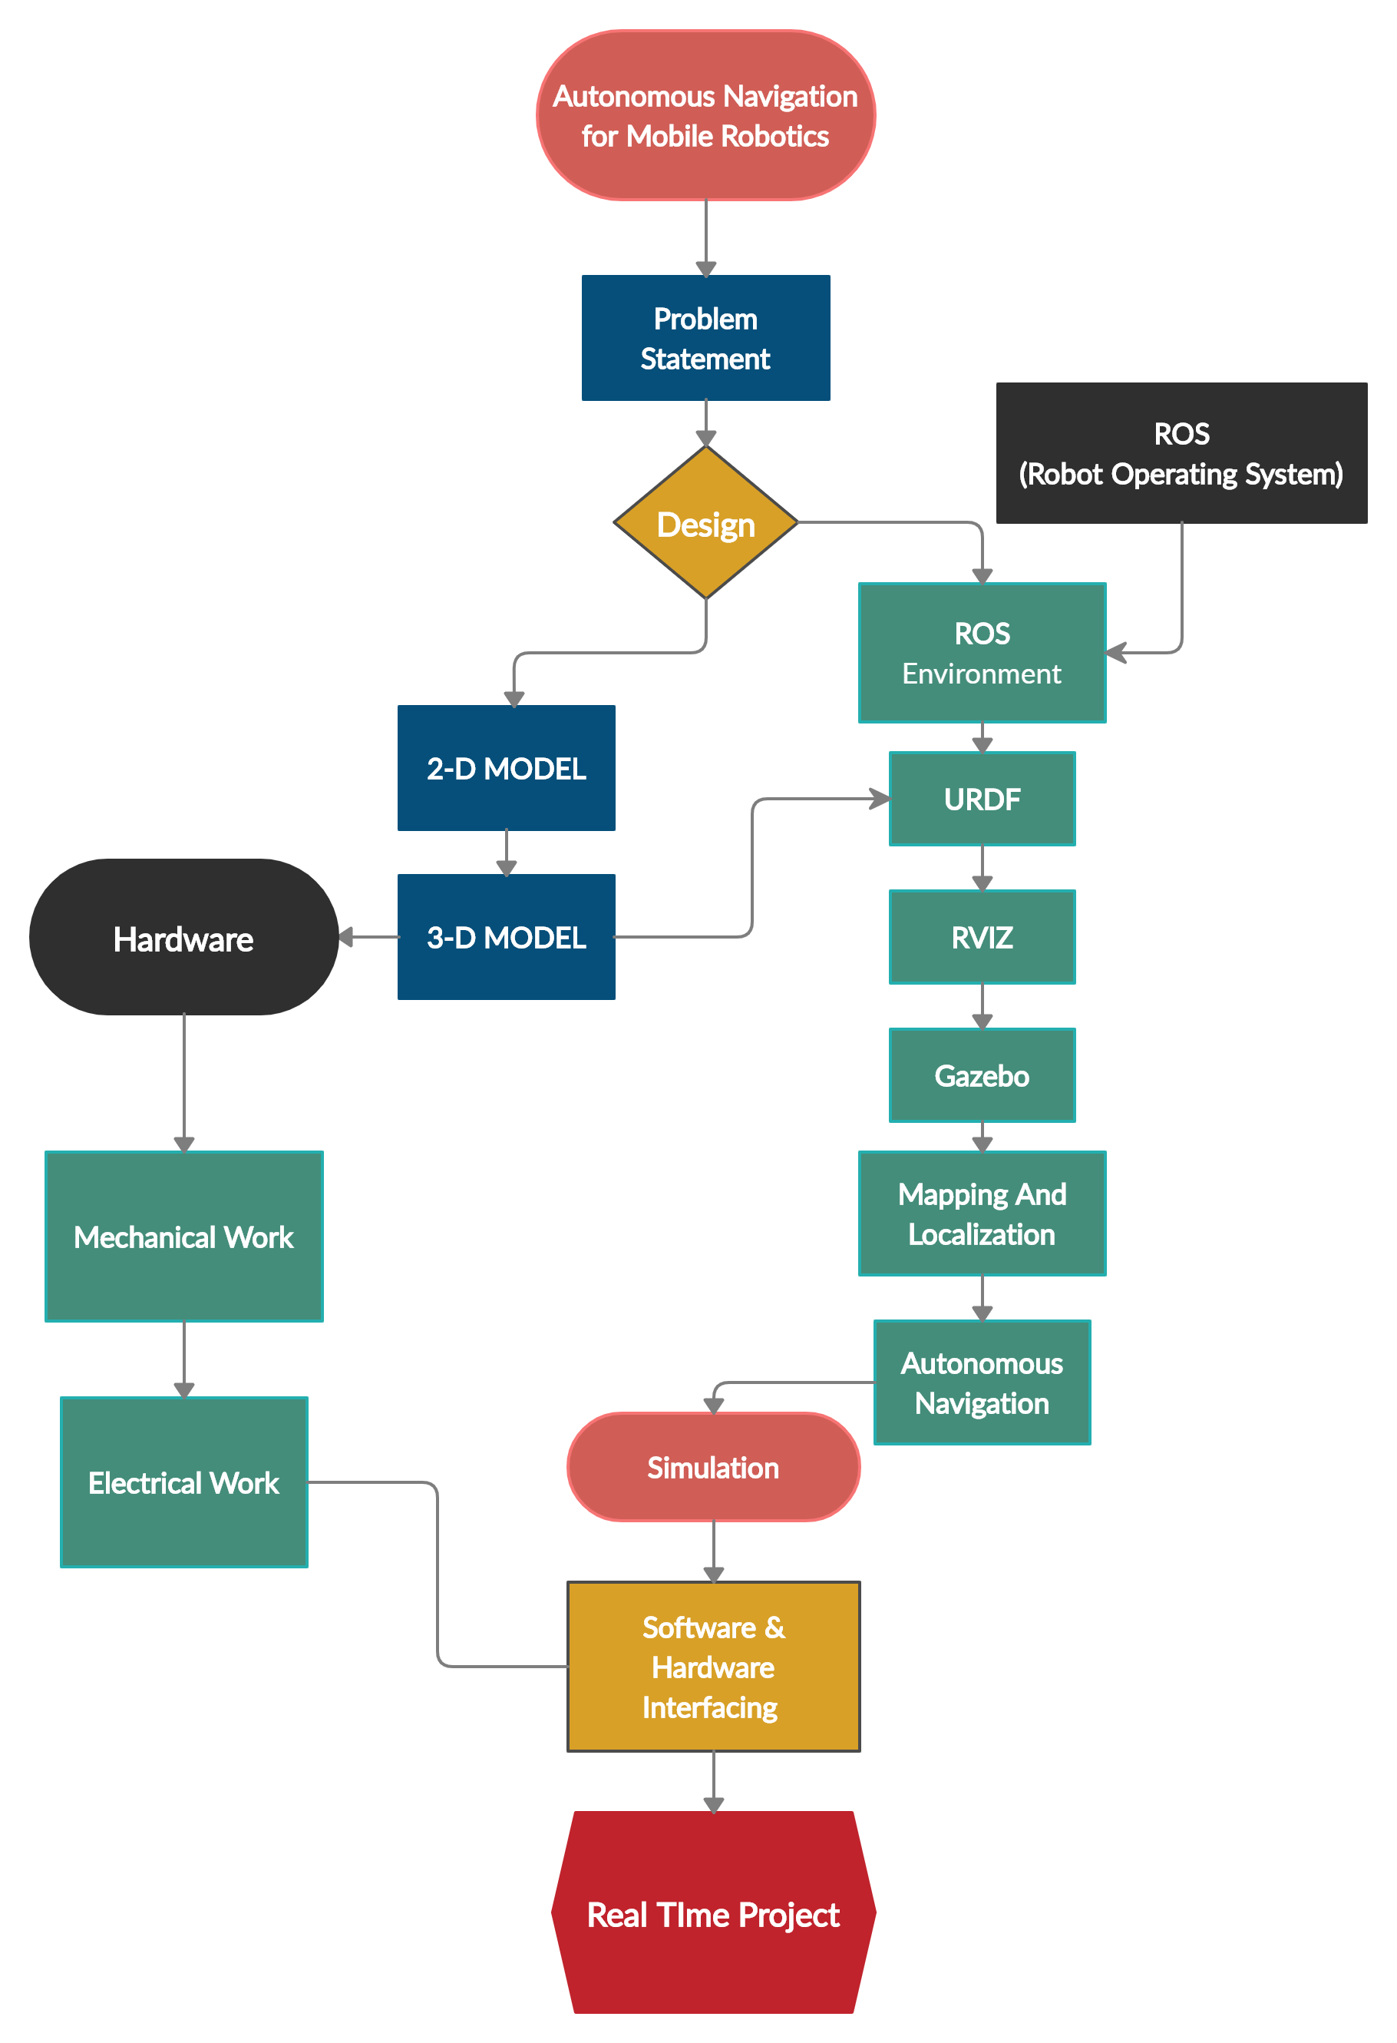
Flowchart

Slide 5
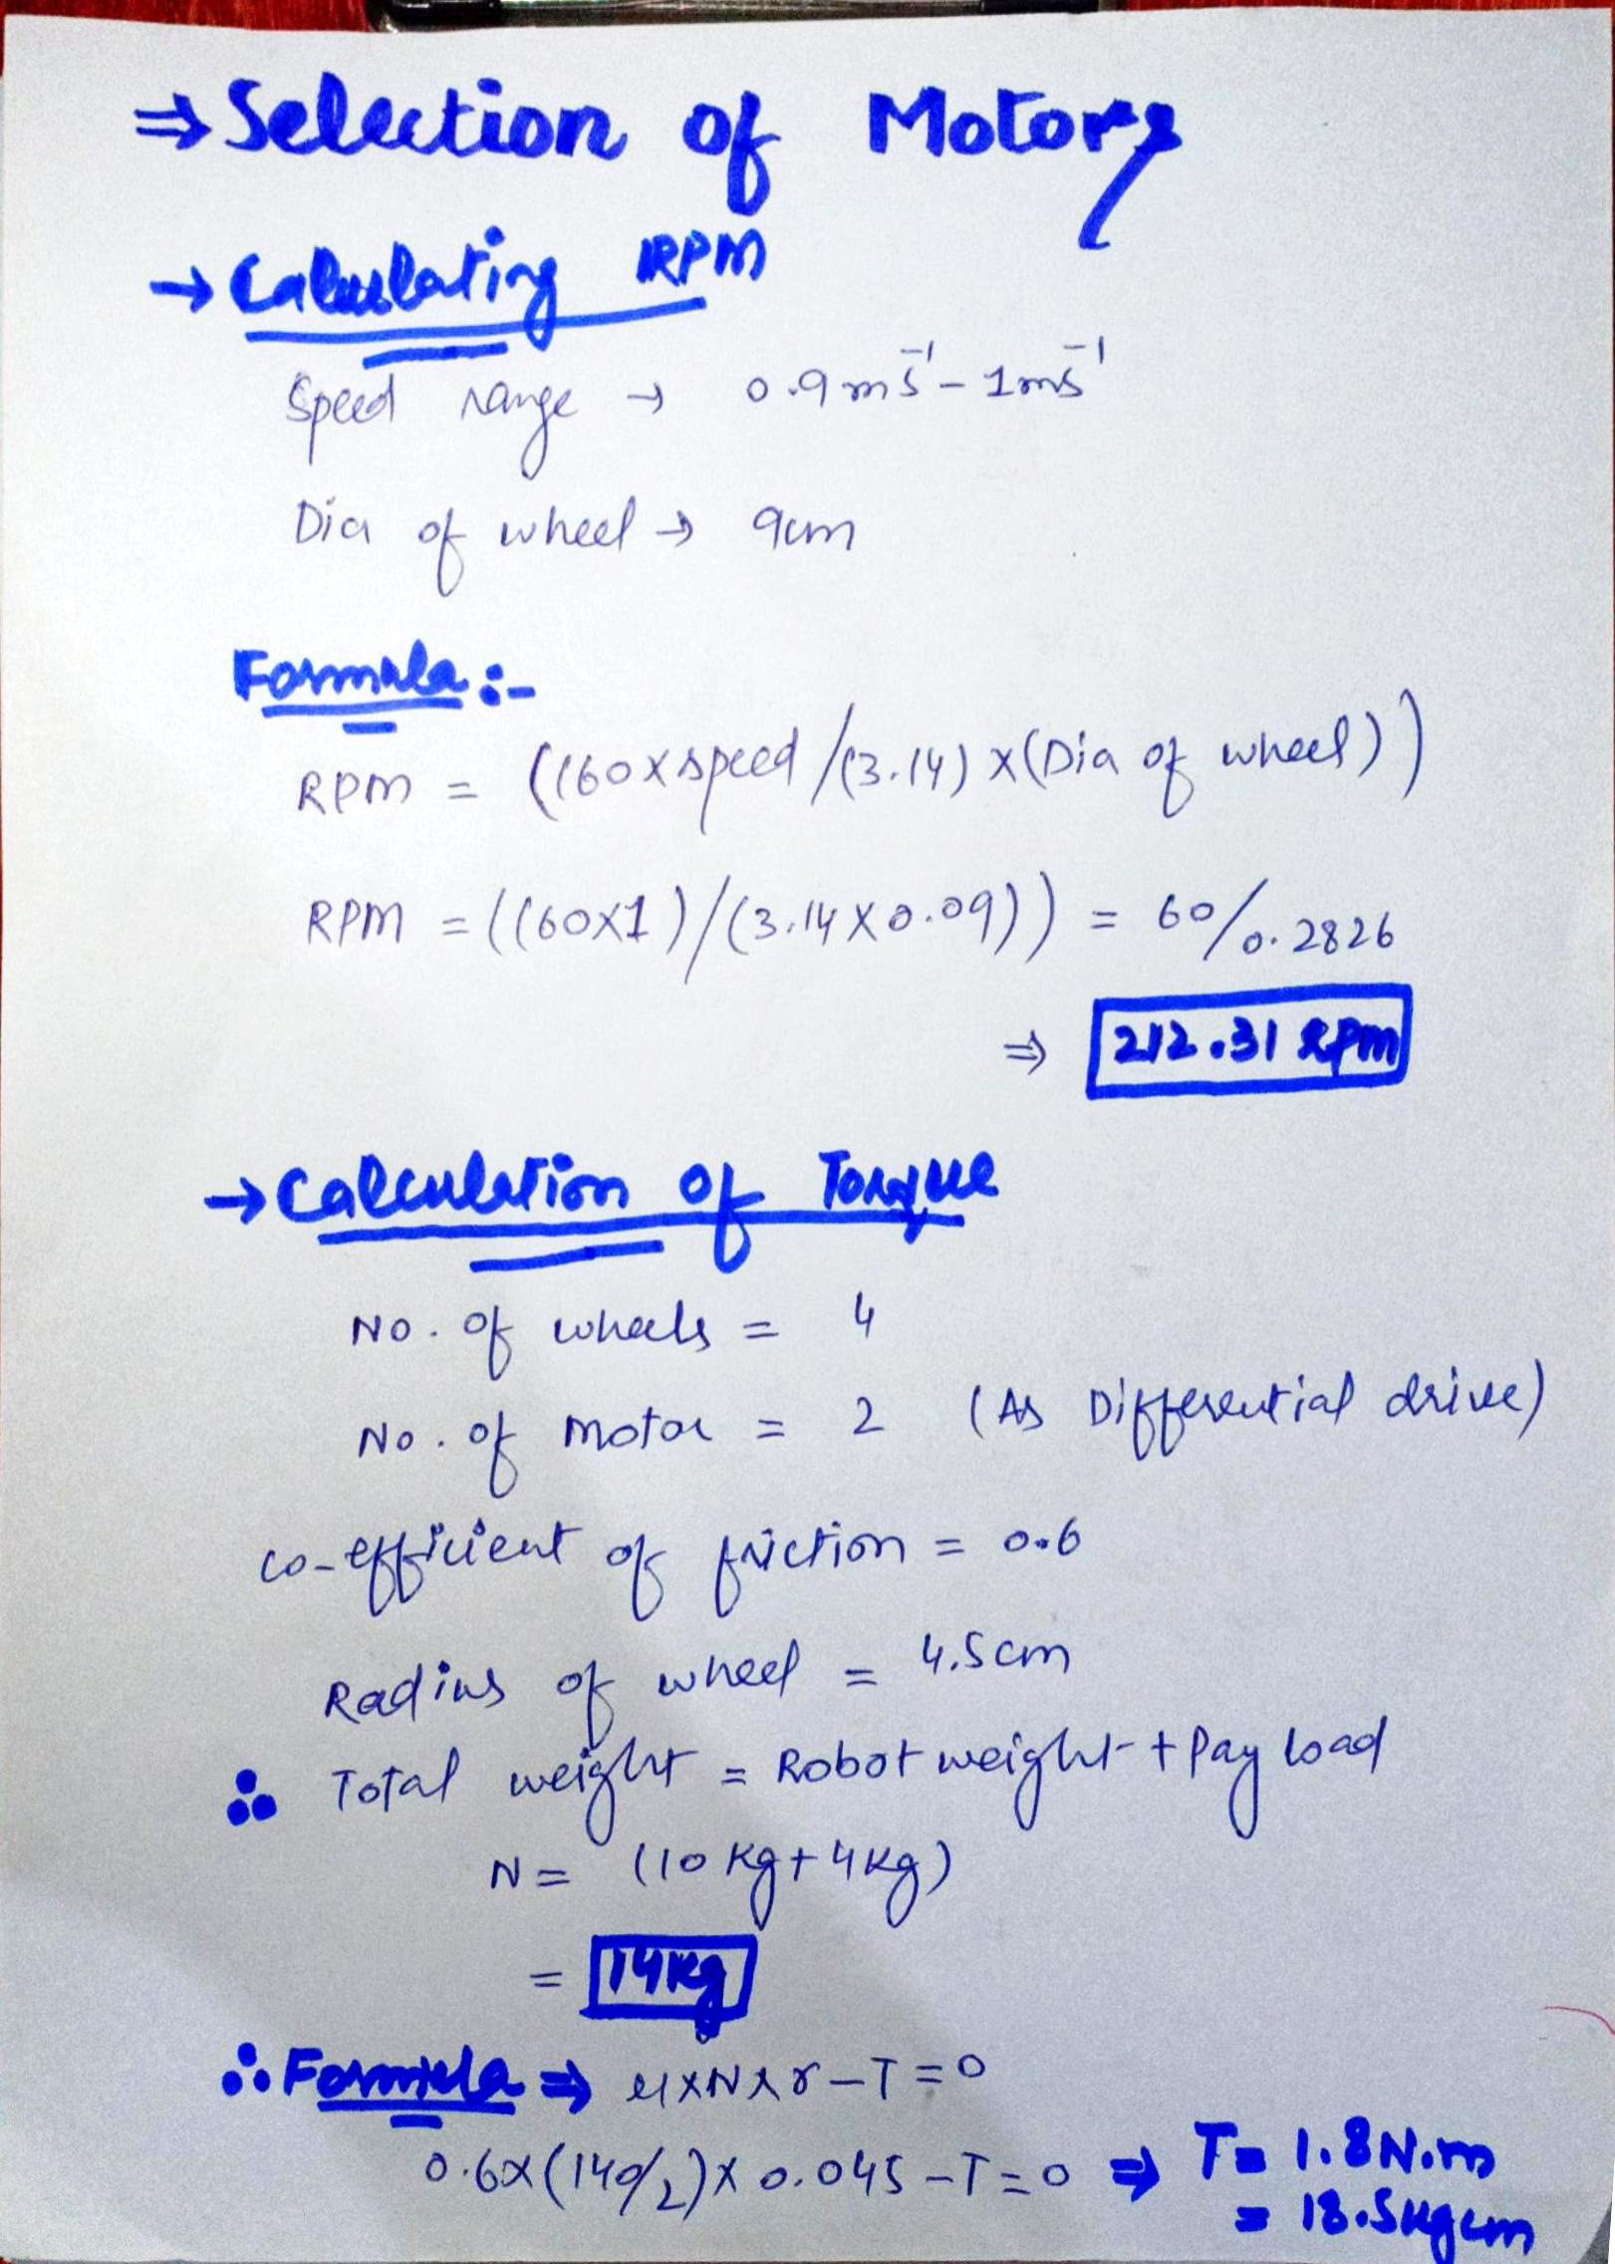
Specification
Parameters
Motor RPM | 215 rpm
Motor Torque | 18.5 Kg.cm²
Wheel Diameter | 9 cm
Base Weight | 10 Kg
Pay Load | 4 Kg

Slide 6
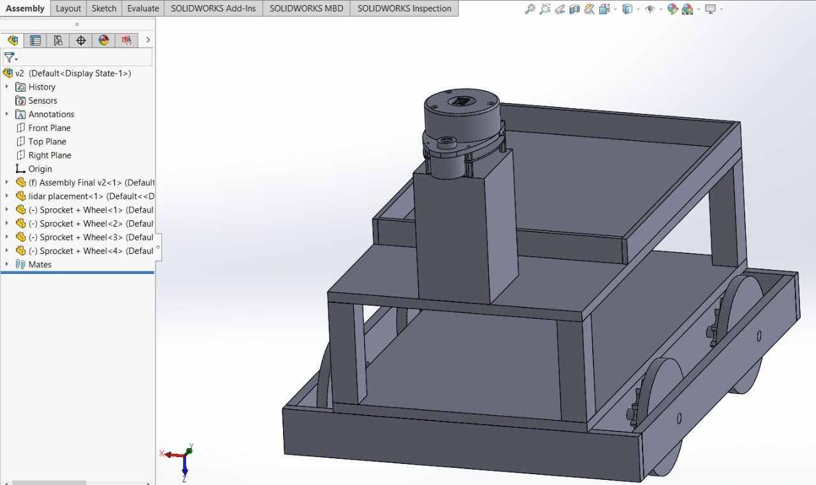
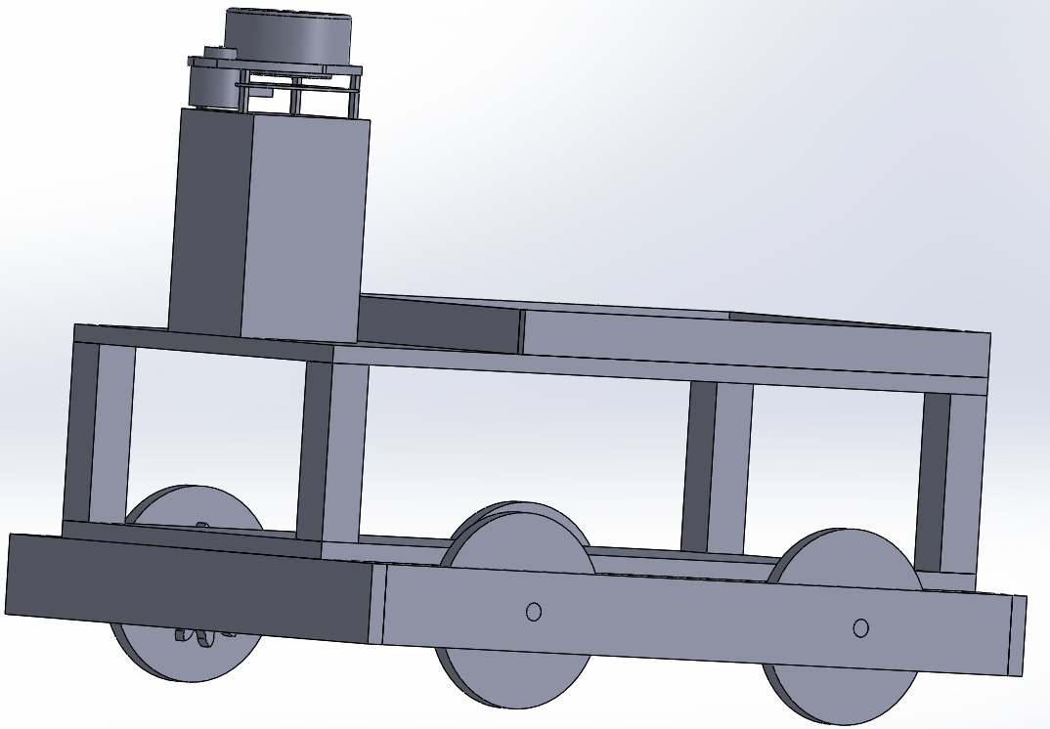
design
3D design
SolidWorks Software
3-D Robot Visualization
Final robot Model
Notes:
3-D Model of a robot is designed for real visualizing of a robot and to import this model in URDF for Rviz and Gazebo simulations

Slide 7
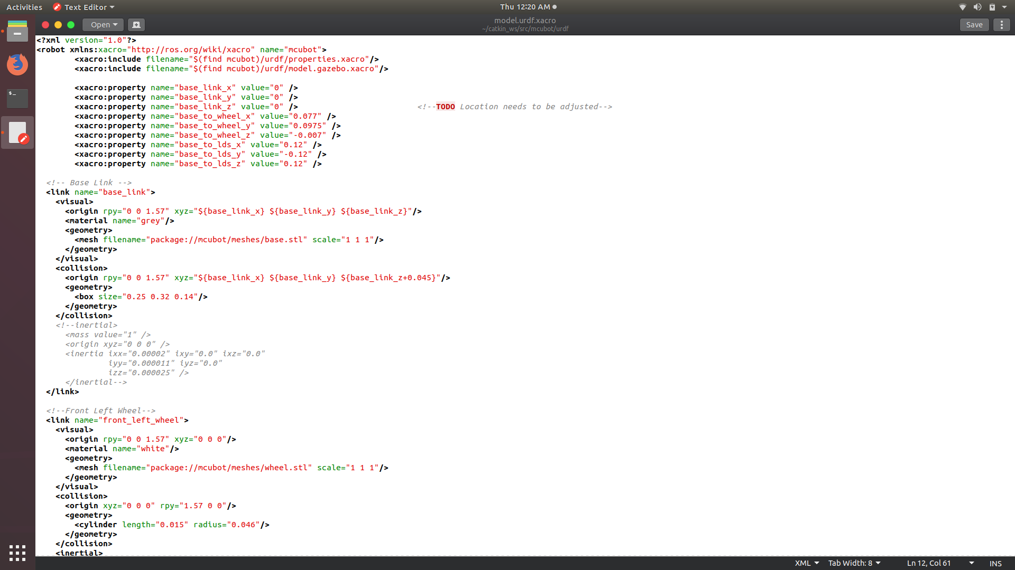
ROS Environment
URDF:
URDF(Unified Robot Description Format)
Format: .xml
Geometry and joint linking of a robot
Visuals
Collisions
Inertia
Gazebo Plugins

Slide 8
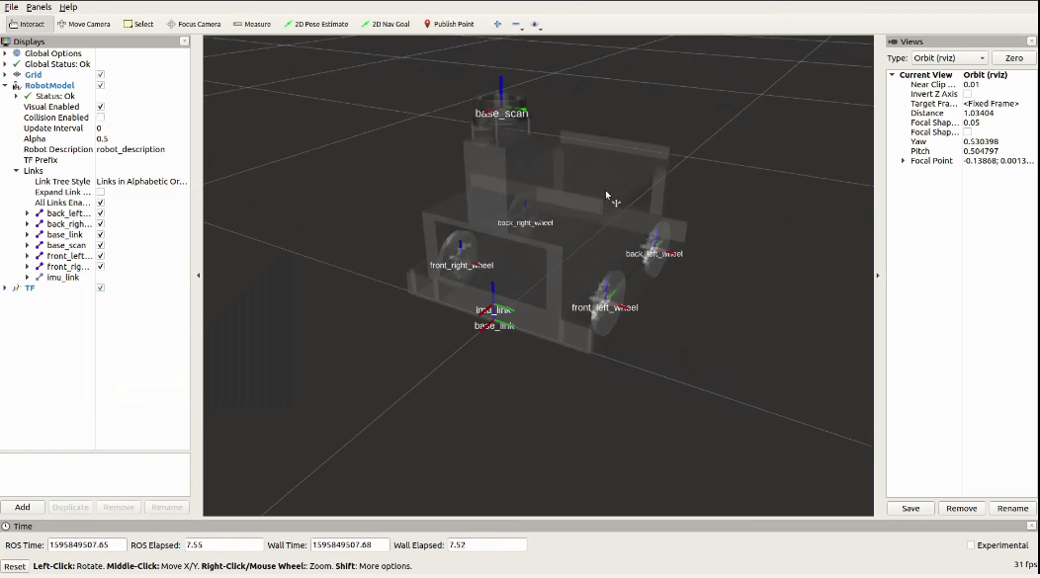
Rviz:
Visualization of Lidar, motors & sensors
Visualization of Joints, Links and Geometry
Transformation of Links
SLAM
Mapping

Slide 9
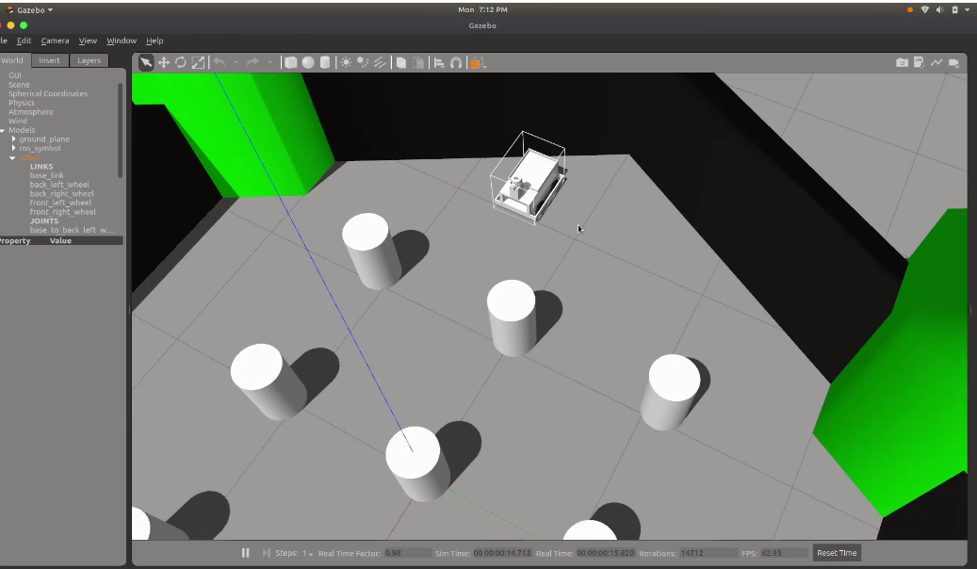
Gazebo:
Gazebo Plugins:
Real world environment
3-D Physical Simulation
Ensuring the real-world functioning
Components | Plug-in | Uses
Lidar | laser scan | Environment Scanning
Differential Drive | libgazebo_ros_diff_drive.so | Manual Motor Control
IMU | imu_plugin | Odometry
Gazebo Control | gazebo_ros_ control | Linking the Gazebo Software

Slide 10
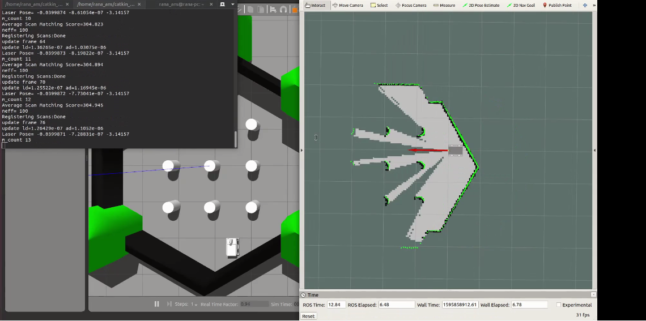
Mapping and Localization
SLAM (Simultaneous Localization and Mapping)
G-Mapping
Localization
LIDAR

Slide 11
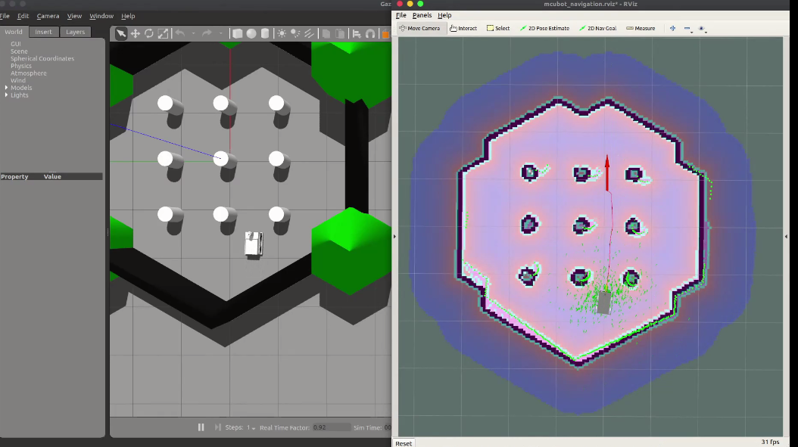
Autonomous Navigation
Autonomous path planning
No human participation
Obstacle avoiding

Slide 12
Physical Implementation
Bring robot in a real-world environment
Building the physical hardware
Placement of Sensors on robot
Assembling Motors
Hardware Software Interfacing

Slide 13
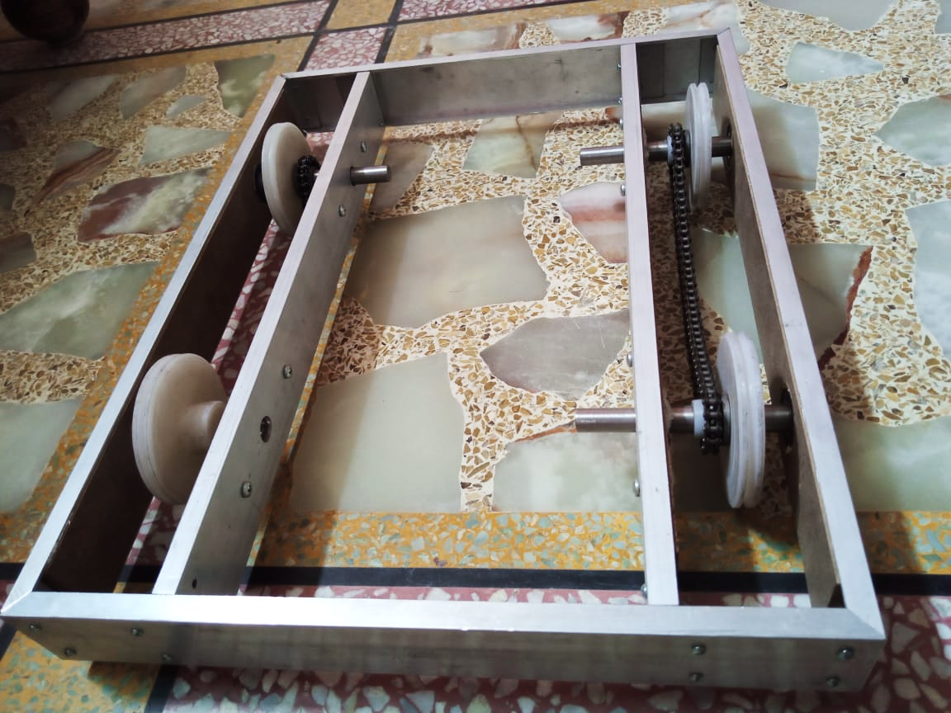
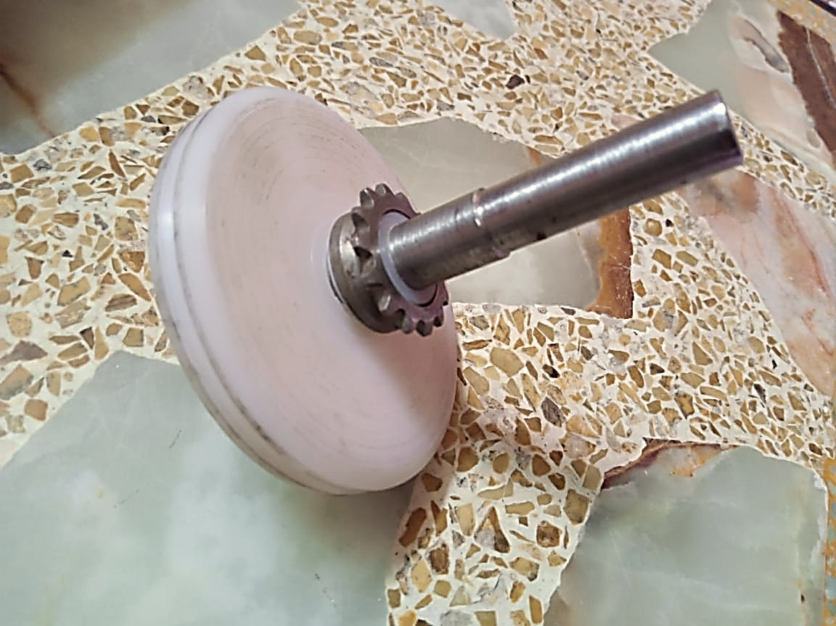
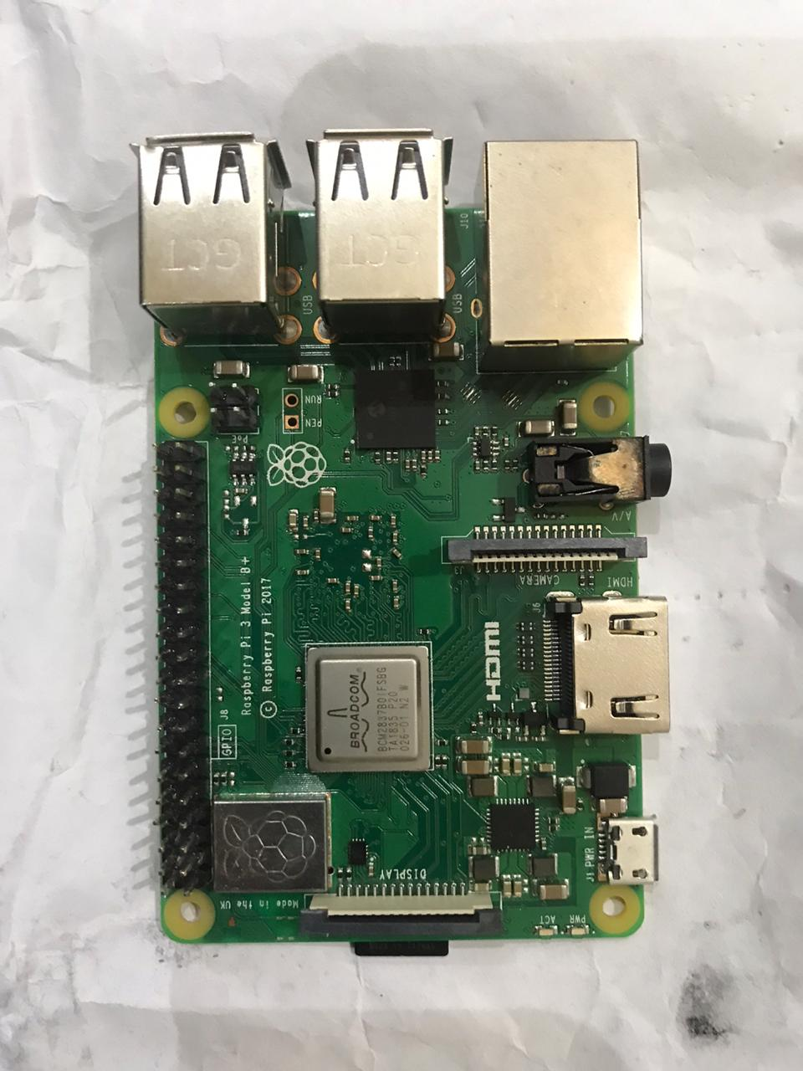
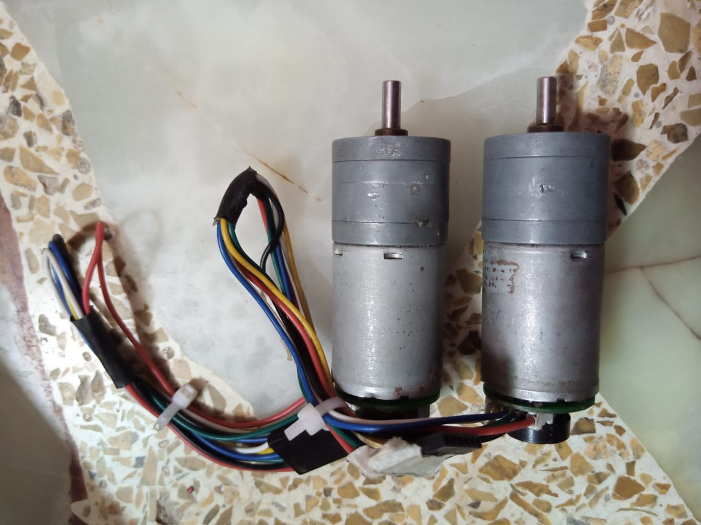
Hardware
Base Frame
Made of Aluminum
Tires
Made of Teflon
Shaft mounted Wheels
Micro-Controller
Raspberry pi
Motors
Pololu encoded motors

Slide 14
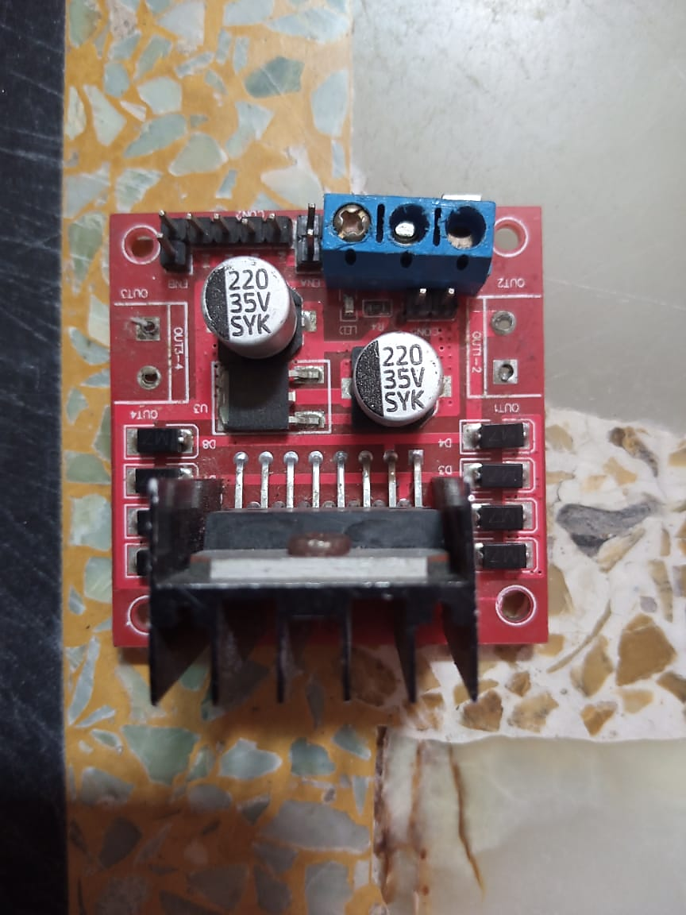
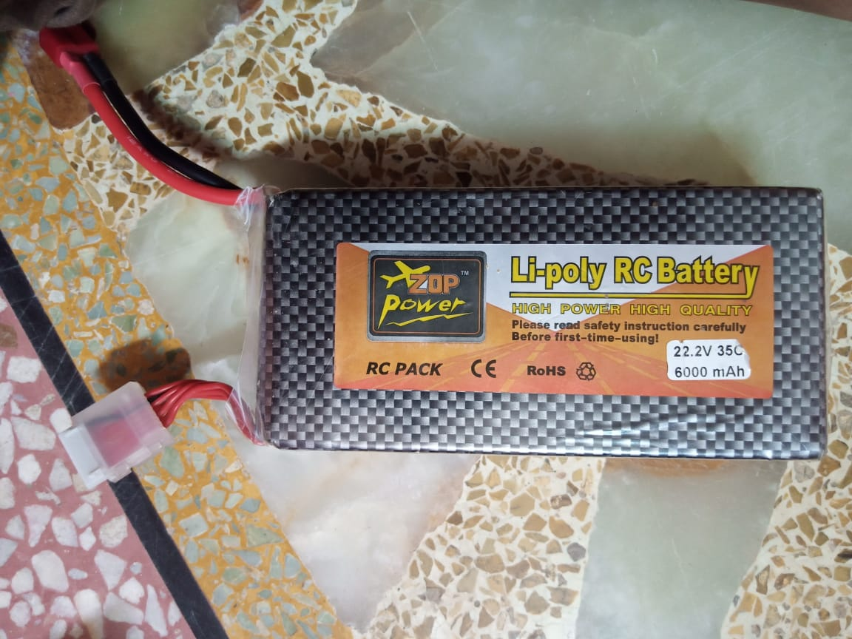
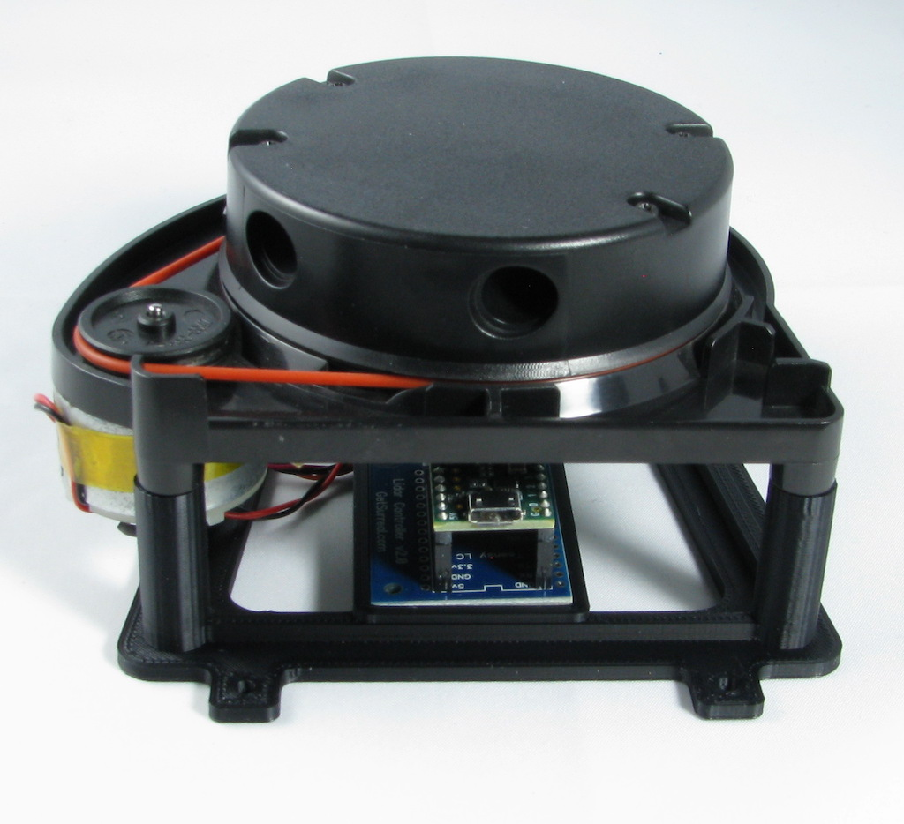
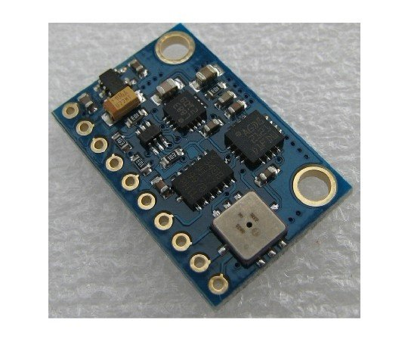
Motor Driver
L298 dual motor driver
Battery
Li-Po 24v Battery
Lidar Sensor
IMU Sensor

Slide 15
Modern Tool Usage
Tools | Uses
Python | Programming Language
ROS | Robot Simulating Software
AutoCAD | 2-D Modelling
SolidWorks 2018 | 3-D Modelling
Discord | Group Meetings and Communication
GitHub | Online Cloud
Latex | Documentation

Slide 16
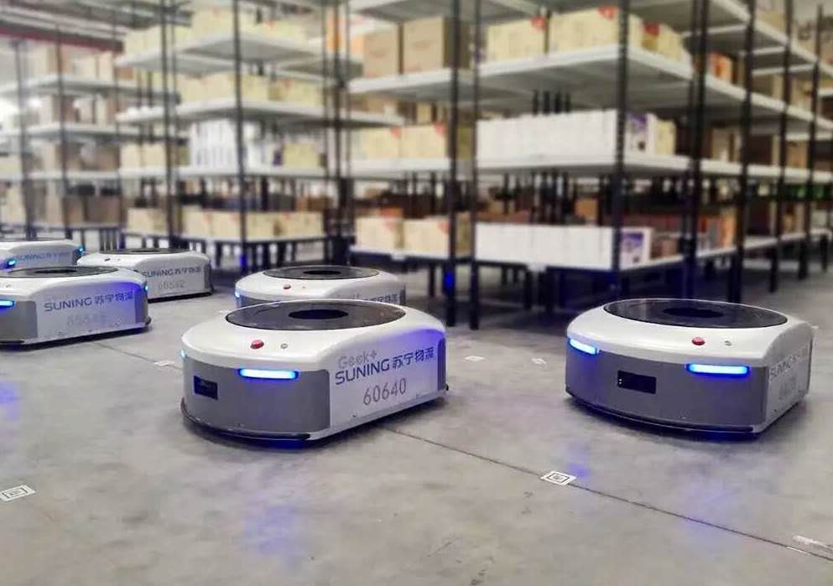
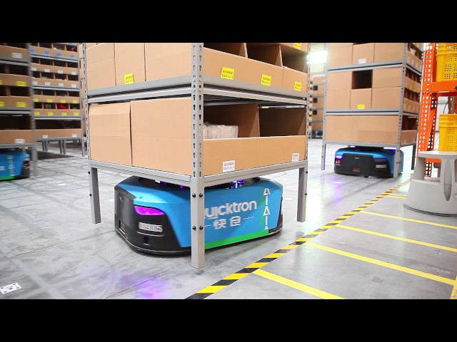
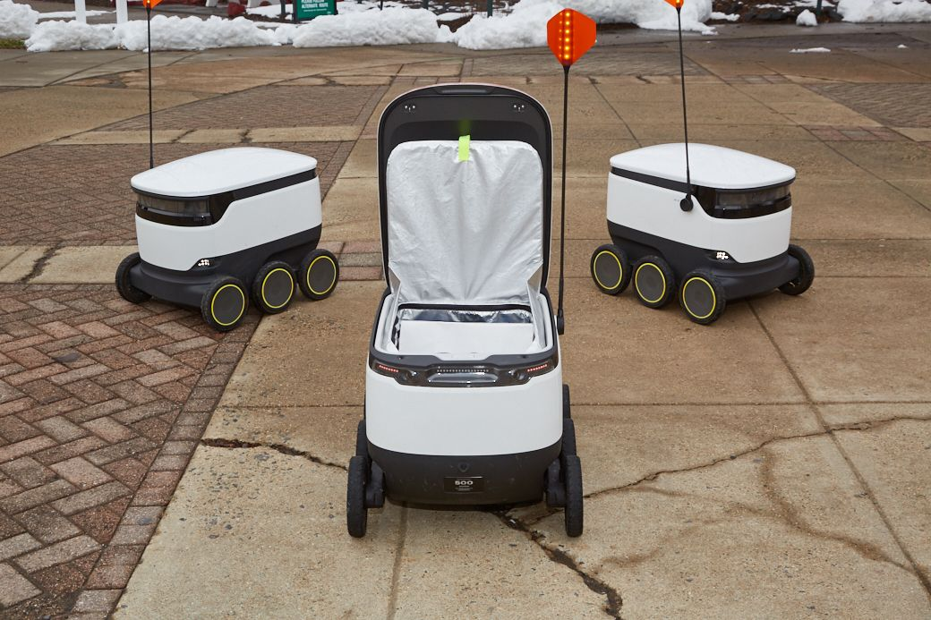
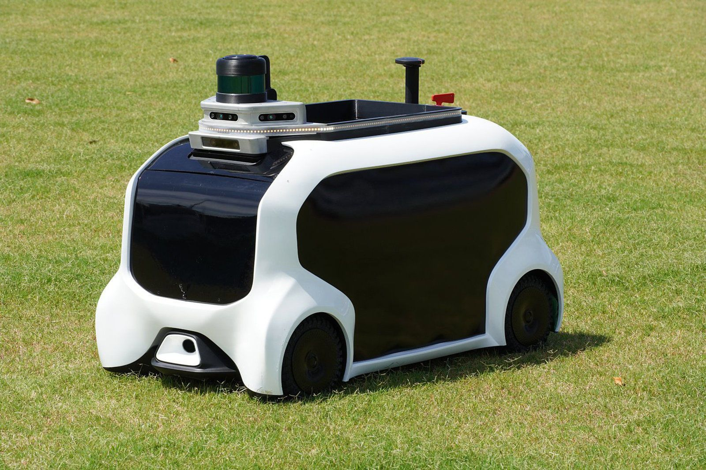
Implementation Areas
Industrial Robots
Social Robots

Slide 17
Conclusion
Achieving basic functionality proved sufficiently daunting that we did not have the opportunity to fully implement more advanced features as we initially planned because of COVID. Although a more sophisticated path planning algorithm was written, it is integrated with the ROS global planner. However, we did succeed in implementing fully functional autonomous navigation, so we surpassed our minimal set of goals.

